Slide 1
Reducing Extreme Poverty through
Skill Training for
Industry Job Placement
Researcher Workshop, IZA|GLM phase II
Abu S. Shonchoy (Presenter)
Research Fellow, Institute of Developing Economies, JETRO and
Assistant Professor, University of Tokyo, Japan.
Selim Raihan
Professor, University of Dhaka, Bangladesh and
Executive Director, South Asian Network on Economic Modeling (SANEM)
Bozlul Hoque Khandker
Professor, University of Dhaka, Bangladesh and
Chairman, South Asian Network on Economic Modeling (SANEM)
21st August 2013, Institute for Study of Labour, Bonn, Germany.

Slide 2
Outline
Motivation
Background
GUK Intervention
Research Design
Research Questions
Other Technical Issues
Conclusion

Slide 3
Motivation: Poverty Angle
Bangladesh is achieving resilient growth for the last one decade (6% annual) despite the global and domestic issues.
National Headcount ration of poverty has reduced to 31.5 percent in 2010 from 40 percent in 2005 (HIES 2005, 2010)
However, Bangladesh still remains a poor country and probably the gains from growth and poverty reduction has been uneven or miss-targeted.
There might be a need for “pro-poor” growth strategy where we can connect the “poverty pockets” with growth poles of Bangladesh by providing job opportunity for the poor.

Slide 4
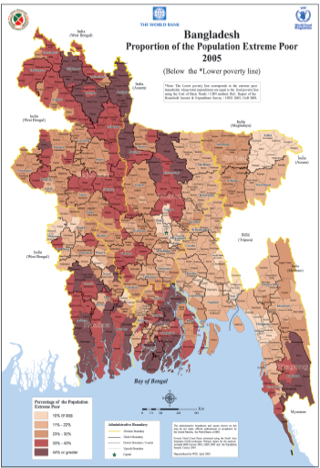
Motivation:
Poverty
Pocket
Northern Bangladesh
(one of the poverty pockets)

Slide 5
Motivation: Northern Bangladesh
Northern Bangladesh is one of the most poverty stricken areas of Bangladesh.
The area is very disaster prone:
a. floods and river erosion during the monsoon;
b. cold spells during the winter and
c. seasonal deprivation and famine-like conditions during the lean season.
Extreme poverty was 17 percent higher in northern Bangladesh compared to the rest of the country in 2005(GOB 2008).
Government provided safety net program is inadequate to reduce poverty (Khandker 2012)

Slide 6
Motivation: Growth Pole
One of the growth poles of Bangladesh is the RMG sector,
-A very large provider of jobs, especially for women.
It has been growing at 15 to 20 percent per year since the late 1970s.
Currently it accounts for more than 80 percent of export earnings (US$12 billion in 2009).
The demand for additional skilled labor is still estimated to be between 350,000 and 450,000 by the (BGMEA) and (BKMEA).

Slide 7
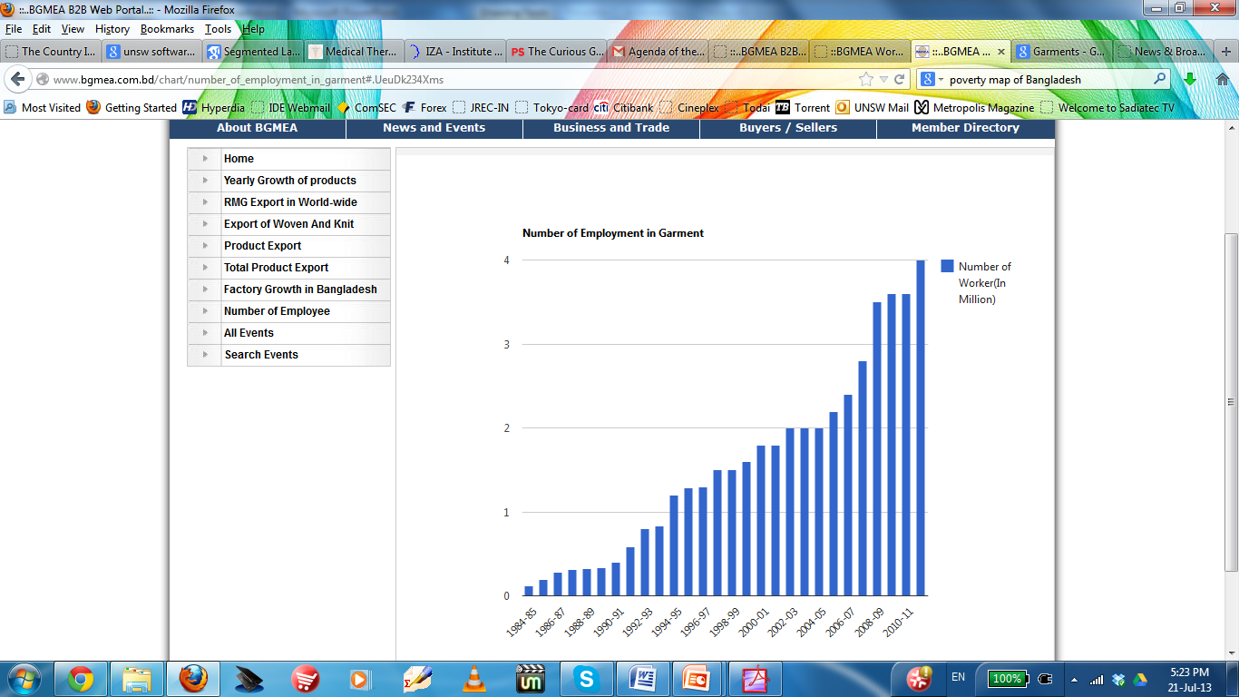
Employment Growth at RMG
Source: BGMEA Website

Slide 8
Motivation
Would it be possible for us to use this growth pole of RMG sectors with the poverty pockets of Northern Bangladesh? We need to know:
What is the current share of RMG workers form Northern Bangladesh? How can we improve it?
Is traditional job referral system sufficient or we need some additional interventions to ensure larger participants from Northern Bangladesh to RMG sector (targeting)?
How these people will ensure skill? Can Technical Vocational Education and Training (TVET) provide this support?

Slide 9
Background
The majority (85 percent) of garment workers are migrants; however, their distribution by source region is rather skewed.
For instances, Northern Bangladesh has the lowest participation rate in the garment industry (according to one BGMEA, approximately five percent of the workers are from the northern areas).
Why such regional difference? Could be due to
- lack of information on job opportunities,
- the absence of social networks in the growth poles, and
- the lack of adequate training, preparation, and support in making the transition to garment factories in urban settings.

Slide 10
Background
Current TVET Intervention by the Government may be inadequate, mostly due to
1. TVET curriculum is not matched with job demand or industry growth
2. The opportunity cost of attending a TVET program to enhance skill for an individual is quite costly, especially if the person is the chief bread earner.
3. There is no job linkage/matching or internship facilities provided by the TVET authority, which also makes the take-up rate and job success rate of TVET quiet limited.

Slide 11
GUK Intervention
Gana Unnayan Kendra (GUK) a local NGO working at the Gaibandha, recently implemented a project titled “Reducing extreme poor by skills development on garments”.
GUK aims at developing skills of interested young women and men of extreme poor families on woven garments.
Initially GUK provides one month long residential training on sewing machine operation for the selected candidates from their targeted beneficiary households.
After completing the course, the trained beneficiary will undertake an internship at a nominated garments, typically located in Dhaka, for two months.

Slide 12
GUK Intervention
With the training, internship, and the financial support of GUK, each household graduates in 12 months with the possibility of securing a job within six months from the intervention.
Started in December 2010, so far 919 individuals (out of which 43% are female) has completed the month long training and 756 individuals have finished the entire program.
Success rate of 91% securing a job at a garments factory

Slide 13
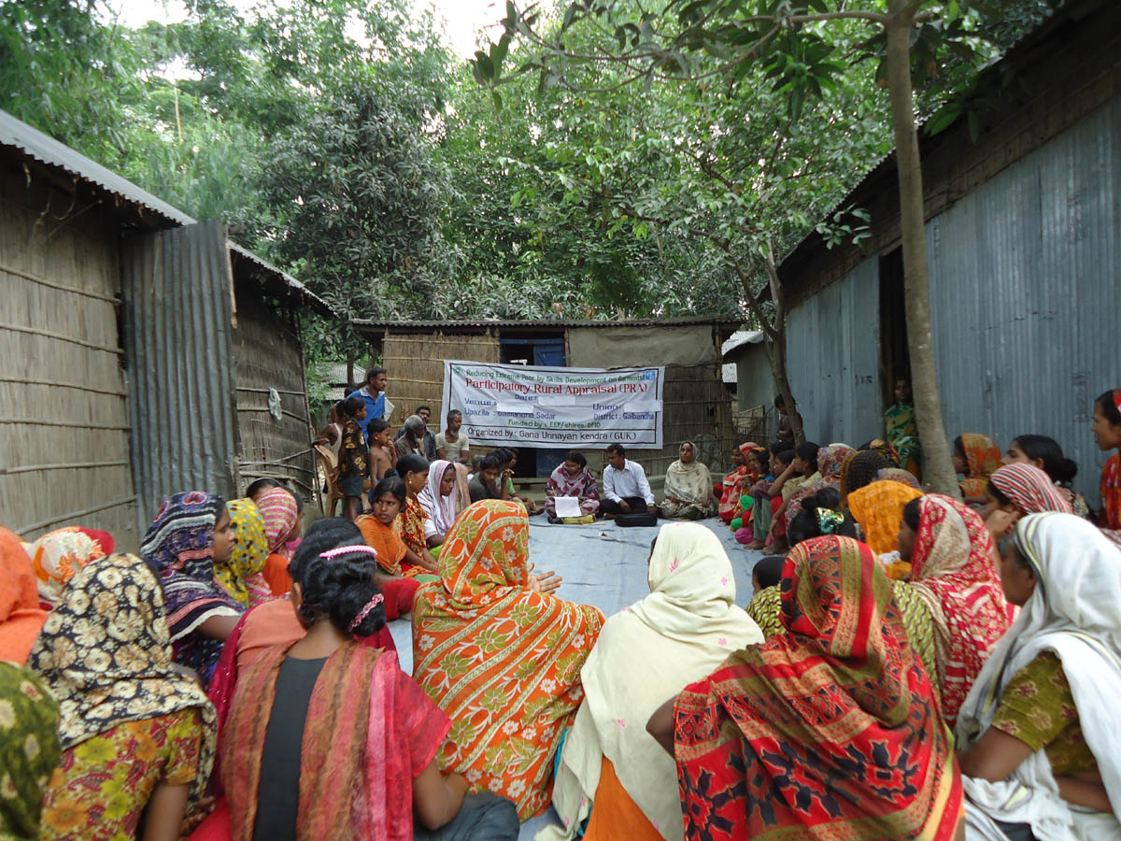
Beneficiary selection: PRA method

Slide 14
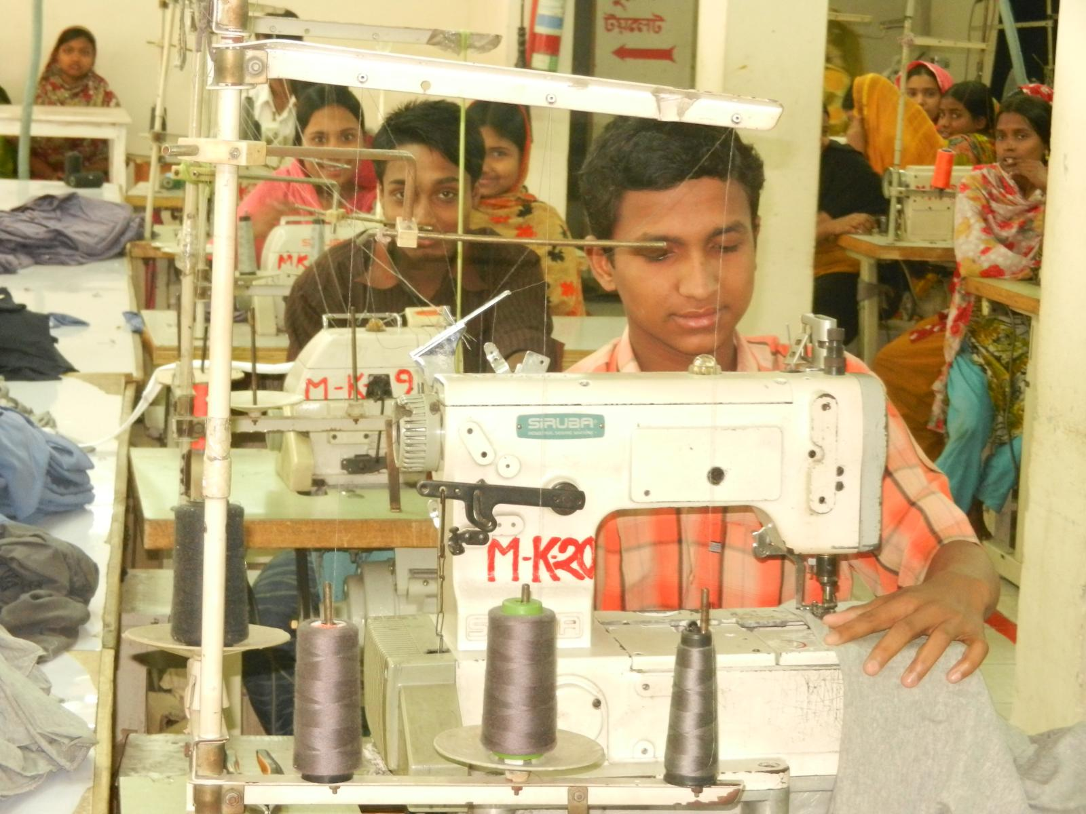
GUK Training Center

Slide 15
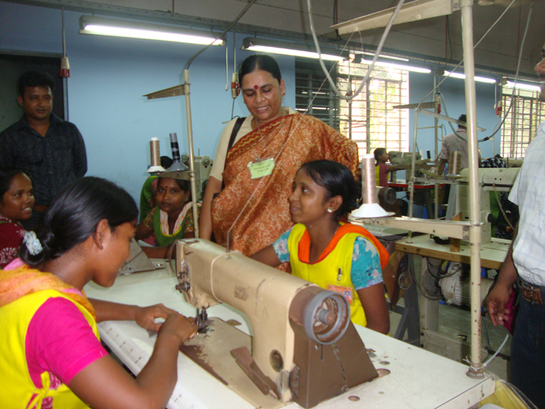
GUK Interns working at a factory

Slide 16
Research Design
GUK’s innovative garments project needs rigorous evaluation.
Does it really work? Which component of the intervention is most important:
a. targeted training?
b. stipend or
c. the internship?
Is there some important lesson we can learn out of this intervention, which will help us to shape our TVET programs to gain more success and achieve better targeting?
To address all these question, we will implement an Randomized Control Trial (RCT) technique to rigorously evaluate the GUK program on Garments.

Slide 17
Research Design
We will select 1600 eligible candidates from Gaibandha who are currently
a. unemployed,
b. aged between 18-30,
c. willing to change their current profession and
d. from moderate poor or ultra poor households.
Once selected, 1600 individual will be randomly assigned to one of the following intervention groups:

Slide 18
Research Design
1600 Eligible Candidates
Information Only
(Job Referral Equivalent)
[400 individual]
Training Only
(TVET Equivalent)
[400 individual]
Training with Stipend
[400 individual]
Training, Stipend with Internship
[400 individual]

Slide 19
Research Design: Household Survey
Detailed Base-line survey
6 months follow-up survey
Detailed Panel Survey (after 12 months)
18 months follow-up survey

Slide 20
Research Questions
The goal of this research project is to gain a better understanding of the effect of the program on take-up rate, survival rate and socio-economic outcomes of the treated individuals.
In terms of survival and completion rate, we aim to address:
(i) Completion rate of the program.
(ii) Trainee’s probability of securing an employment and
(iii) Trainee’s probability of continuing to be employed for a certain amount of time (survival rate) in the garment industry (after 6, 12 and 18 months).
(iv) Job referaals and remitance flow

Slide 21
Research Questions
Thus, in terms of socio-economic outcomes and household-decision making we plan to address:
(v) What are the causal effects of the program (for example earnings and assets after 6, 12 and 18 months);
(vi) Trainees, especially women’s health and behavioral outcomes (for example, empowerment);
(vii) Level of satisfaction with the project among graduates of the training program;
(viii) Living standards of dependents of the trainees, especially during the period of lean period hardship (number of food intake, educational or health outcomes, for example);
(ix) What is the role of heterogeneity? Among man and women;
(x) What are the impediments to program uptake?

Slide 22
Research Questions
Addressing these questions will allow us to formulate a nuanced answer to the following policy-related questions:
(xi) What do we learn about the cost effectiveness of this program in the Bangladesh context?
(xii) What does observed heterogeneity tell us about targeting of future programs of this sort?
(xiii) How can other countries learn from this experience?

Slide 23
Other issues: Cost effectiveness
Job Corps, a well established and rigorously evaluated program for disadvantaged youth in US, is known for is substantial cost as the cost per participant for the program is ranging from $13,000 to $15,000 (Adams 2012).
The cost for per participants in Latin American Joven programs has been estimated with a range from $750 in Colombia (Attanasio et al. 2011) to $2,000 in Argentina.
However, the GUK Garments project, the cost for participant is $154, substantially less than other youth training and vocational training programs, exist in the world.

Slide 24
Other Issues: Ethical Ground
Proper care will be taken for the research to involve only those who are interested, after filling a consent form.
Information only group intervention will be executed at the village level as well as at the individual level (currently planning to have more controls); to capture spillover effects as well as pure control.
Other treatment interventions will be at the individual level, where during the program advertisement, only the training component will be campaigned. Other additional benefits (like stipend or internship) will come as a surprise and will be decided by a lottery.
Training only group may be given bus-ticket to go to Dhaka.

Slide 25
Other Issue: Tracking
Attrition could be an issue, one the subjects are in urban set-up.
However, we hypothesizes that most of the subject will migrate temporarily, i.e. there core family will be traceable at the village.
To improve the follow-up survey and reduce attrition, an incentive of mobile SIM card will be given to each individual under the program (1600 in total). Moreover, for participating each follow-up survey, 600 taka of talk-time (flexiload) will be transferred at their mobile number.
Respondents who will find it difficult to come for follow-up survey, we will provision for telephonic interview.

Slide 26
Conclusion
Providing job-opportunity to the Monga-Prone population could be a solution to reduce the seasonality led poverty at Northern Bangladesh.
One effective Pro-Poor growth strategy for Government of Bangladesh is to connect the poverty pockets with growth poles. Our proposed research will help government to understand how we can achieve this with better targeting.
Majority of the garments workers are female, hence our research will also help us to understand how female employment could change the intra-household welfare and decision making.
It will also help us to rethink on how we can change the way TVET typically works in Bangladesh.

Slide 27
Questions and Comments are welcome!
Thank you

Slide 28
Reference
Adams, A. V. (2012). "The Role of skills development in overcoming social disadvantage." Background paper prepared for the Education for All Global Monitoring Report.
Orazio Attanasio, , Adriana Kugler, , Costas Meghir. (2011). Subsidizing Vocational Training for Disadvantaged Youth in Colombia: Evidence from a Randomized Trial. American Economic Journal: Applied Economics 3:3, 188-220.
Bangladesh Export Processing Bureau (2009). Annual Report on the Ready Made Garment Industry,.
Bangladesh Garment Manufacturers and Exporters Association (2010). Ready Made Garment Yearbook.
Government of Bangladesh. 2008b. Household Income and Expenditure Survey 2005 Report.
Dhaka, Bangladesh: Bureau of Statistics
Khandker, S. R. (2012). "Seasonality of income and poverty in Bangladesh." Journal of Development Economics 97(2): 244-256.
World Bank. 2008. Poverty Assessment for Bangladesh: Creating Opportunities and Bridging the East-West Divide. Bangladesh Development Series Paper No. 26. Dhaka, Bangladesh: The World Bank.
World Bank. 2009 Addressing Extreme Poverty in Bangladesh: The Case of Monga. Concept Note. Unpublished.

