Slide 1
URN:NBN in the Netherlands
Notes:
Goal of this talk:
Explain the Dutch NBN solution, its history, current state and the (nearby) future
(The need to focus on commonalities rather then differences)

Slide 2
Outline
Introduction
Origin of Dutch NBN system
Current state
Future

Slide 3


SURFshare Repository Infrastructure
SURF & SURFfoundation
Continuation of DARE programme
  Collaboration between 30 institutional repositories
  DANS and National Library as longterm archives
“Create a common infrastructure that will facilitate access to research information and make it possible for researchers to share scientific and scholarly information”
Notes:
Surfshare is a program run by SURFfoundation, which is a part of SURF
SURFshare continues where Darenet stopped
Darenet succeeded in connecting up to 30 repositories to a central portal to its contents: narcis.info
SURFshare will turn this into a common infrastructure that will
PID’s, Enhanced Publications, Statisctics , …
A more prominent role for data

Slide 4
SURFshare and PID
Location independence
  Within organizations
  Between organizations
Sign of commitment
  Identifiers should be recognizable
Heterogeneity of access
  Clear access to an object, its startpage or its metadata
Notes:
Location independence: the evident reason for pid’s.
Repository-changes cause changes to URLs
Ownership and copyright issues cause resources to transfer to other institutions
“It happpens that when researchers move no another institute, their publications will be transferred to their new institute.”
Commitment
The existing repositories had a wide range of different identification-strategies and systems, some used multiple. It was not clear to the user whether is was a safe link to cite, or what the user could expect from that identifier.
Heterogeneity
From the portal (narcis.info) you would not know what you would get after clicking the item: a metadata record, a nicely formatted and university branded startpage of the resource of the resource itself (a PDF).
It is “acceptable” for users who know how to click, but not usable for automated access, e.g. processing of data, linking between publications and data, fetching the publication for longterm preservation

Slide 5
Requirements
Consistent identification and access
  Permanent (>100 years)
  Inter-organizational transfers
Independence
No/Little impact on existing repositories
Notes:
These are some of the main Requirements
Permanent: dangerous to depend on current technology or organizational structures
Transfers between organizations: objects tend to move to other repositories when their authors change from employer. In order to support those, no namespace can be exclusive to a certain organization or repository
Repositories have dealt with a lot of changes and were not to implement severe changes to their systems and assignment was not to have ANY impact on existing workflows
Independence: The amount of dependence on other organizations or technology needs to be balanced. A certain level of control is needed to ensure that future needs can be fulfilled.

Slide 6
Main Candidates
Handle
  Advanced resolution system
DOI
  Well-defined policy
URN
  Initiated by IETF and W3C
URN:NBN
  Supported by national libraries
Notes:
Honour Handle for its resolution system, honour DOI for using Handle and adding policy, honour URN for its origin in the web community, honour URN:NBN for its context of national libraries and archives. Honour DNB for their distributed implementation which could easiliy be copied in the Netherlands
Only if people ask why not X?
Handle: no policy. In order to develop one and to distinct from other handles, we would have needed another recognizable namespace.
Handle: the software/protocol at that time did not fit our needs.
DOI: the domination by non open access publishers, while we were open access libraries and data archives.
URN: no need to start our own fragment
Uniform Resource Name
Internet Engineering Taskforce
World Wide Web Consortium

Slide 7
URN:NBN:NL
Namespace via national library
Infrastructure similar to DNB
Reuse of existing OAI-PMH infrastructure
Need to develop harvester and resolver
Setup registration agency
Notes:
Explain our choice
- The only dependence that this namespace implies is an agreement with our National Library, and of course the RFC specs
Our needs (and the solution to these needs) were very similar to those of the DNB, who aso had a decentralised system running, connected via OAI-PMH
Local systems could implement identifier generating and assignment within their own systems and expose these in the existing OAI-PMH metadata (MPEG21-DIDL)
A resolver and a harvester is all that is needed
And a registration agency!

Slide 8
Current Situation
Over 500.000 identifiers from 20 repositories
About 10 repositories ready to connect
Registration agency still informal
Requests for identification of large/granular collections (over 100.000 items)
Notes:
The resolver had been built and has connected over 20 repositories serving half a million identifiers. 10 repositories are ready to connect.
Registration agency is still informal. Currently done via phone/email correspondence. Majority are repositories of existing SURFshare infrastructure.
Example of large collection: A researcher who has digitized parliamentary reports identifying every statement from every politician. There is a need to cite these.
(polidocs.nl)

Slide 9
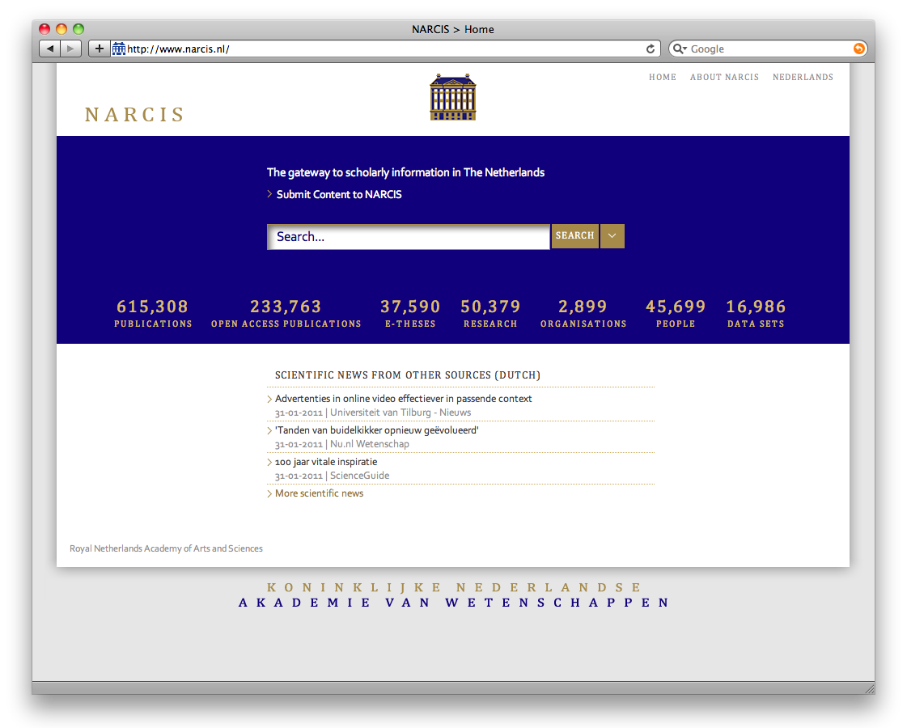

Slide 10
National improvements
Integration with other national infrastructure
  National metadata aggregator and portal
  National Library eDepot
Formalize policy
  Registration agency
  Derive policy from PersID
Improve service
  Registration via web service
  URN to Metadata connection
Notes:
Integration with national infrastructure:
The national portal is already putting 1 fte into managing the different repositories. Why not share these efforts? Problem: national portal indexes only part of the dutch academic ouput, not the output from researchers publishing via eg university publishers. Need for a complete set via a national aggregator with Portal (narcis), Resolver and eDepot as consumer
Managing 3 times 30 repositories (90) becomes 1 time 30 repositories and 3 times a central repository (33)
Items can now be synchronised: publish link in portal once it is resolvable. Identifiers within National Library can be reused or aligned with pids.
Formalize policy
Setup a formal registration agency allow users to register
Formalize who can join and what can be registered
Improve service
Allow users to register identifiers via webservice: less ‘lag’ (identifiers are immediately resolvable) and transfer of responsibility (pull becomes push)
Registration via webservice → Similar to Handle / Epic
Connect the resolver to the metadata catalog which allows requesting structured metadata via the pid.

Slide 11
International improvements
Among NBN partners via PersID
  Shared policy
  Shared services
  Shared communication
Among other PID systems
  Archives participate in multiple ‘infrastructures’
  Basic level of interoperability?
Notes:
Among NBN
Shared policy: what can a user expect from every URN:NBN?
Shared services: all distinct national implementations connected to single entrance,
Shared communication: better explanation on What NBN’s can and cannot provide.
Among other PID solutions
Various organizations have chosen various solutions for their own (often) valid reasons. Given a minimum level of service/policy, this should not hinder them to participate in various infrastructures (national or international (FP7 like CLARIN, DARIAH, CESSDA, EUROPEANA, DRIVER))
Users / tools should be able to anticipate on a certain level of service for a certain period: fetch object, fetch metadata
Where interoperability is difficult it can be replaced with transparency

Slide 12
Summary
Desire for cooperative solution
  Trust and transparence
Basic resolution in place
  Improve service
  Integrate with national infrastructure
International harmonization
  Among NBN
  Among all PID

Slide 13
Thank you

