Slide 1
Why Do We Need Persistent Identifiers?
Dr. Markus Quandt
GESIS – Leibniz-Institute for the Social Sciences
Workshop: Persistent Identifiers for the Social Sciences
University Club, Bonn, February 1&2, 2011

Slide 2
This Talk
What is a Persistent Identifier?
Three scenarios:
Citing data
Finding data
Linking data
Perspectives
Notes:
From my perspective as a researcher and a data distributor, I’ll present some loosely organized thoughts on the possible benefits of PID systems to different groups of people, such as data producers, researchers, data distributors. Of course, there is also the group of developers of technical platforms, these will have their opportunities later on.
As a social scientist, I also like to dwell on very basic insights - I hope you can tolerate that.

Slide 3
What is a Persistent Identifier?
A PID is…
A unique name for some (digital) entity
Allows unambiguous identification of the entity
…and of its location!
Persistence: the PID lives at least as long as the entity itself
Notes:
Of course, there are identifiers for objects outside the Web, but these are not relevant here.
While identifying an object is not the same as knowing its location, locating objects is the predominant purpose of PIDs used in the Web.
Persistence: you logically cannot grant PIDs to objects which are not persistent themselves

Slide 4
Citing Data
Main functions of a citation:
Identify the source = grant replicability of an analysis
Identify contributors = assign responsibility and merit
But data seem difficult to cite…

Slide 5
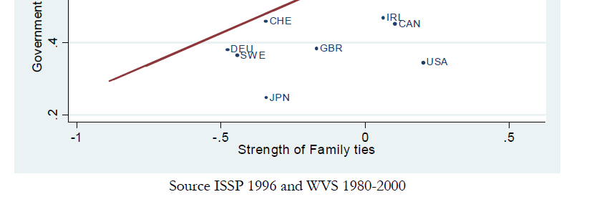
Among some fifteen papers checked for citations of “ISSP Role of Government”, none listed the data set in the references section.
Notes:
A typical example for appearance of data sets in lists of references: blank page

Slide 6
Citing Data
Data sets are not books – therefore, messy citations are problematic:
Data sets do not have simple titles …but complex metadata needed for proper interpretation.
Data sets can have many versions … sometimes concurrent, sometimes superseding, but usually very similar to each other at first look.
Data sets can come from many sources/distributors, in many formats …without a guarantee about equivalence across sources.
Notes:
„Work“ vs. „Manifestation“.
„Work“ is the intellectual entity, a piece or collection of ideas or information.
„Manifestation“ is the file – nowadays, this always means one or more digital objects.
When (and IF) data users cite data, they very often just refer to the “work”, by just giving a title, whereas a proper citation would refer to the manifestation.
Data sets are much more “living objects” than books are: they experience frequent updates and revisions, and they need ecosystems of contextual information around them. In these ecosystems, the datasets itself start evolving…

Slide 7
Citing Data
Data sets are not books – therefore, it seems difficult to give their creators due credit:
Data sets go through many stages …with different contributors at each stage.
‘Invisible’ creators and contributors lack incentives
To produce quality;
To publish (and thus share) their work!

Slide 8
Citing Data …with PId
Messy citation conventions versus doi:10.123/1234567890.abcdec
From no method at all to a high-tech method, more fit to machines than to humans???
Initial benefit at data creators’ and distributors’ end
Immediate credit/reputation building
Impact tracking
Notes:
The vision: we get a data citation standard. For people citing data, ANY citation rule is a burden, in particular one that uses awkward numbers.
Why, then, should researchers as data users want to adopt data citation methods?
Alternative title for my presentation: who wants Pid?
Well, how did the habit of citing publications come about? It is a very strong norm, with severe sanctions if you don’t comply.
Probably, a norm of proper citation is just a public good, for authors of data as much as for authors of texts.
If it is a public good for researchers, it will be not the researchers pushing this… Who will?
Going by the publications’ example, who introduced electronic identifiers for books and articles? Publishing houses (crossref: DOI) and libraries!
Same with data: PID are beneficial at first for data producers and for data distributors and managers. But then, they allow them to deliver better services to their end users!
Here, PId should be as a kind of physical foundation for allowing any IP benefits, to anyone.

Slide 9
Finding Data
For books and articles, we have:
Editors’ catalogues, central registries of books
Library catalogues
Google Scholar
Commercial databases
For data, we have:
Everything specific to a given research field:
Data archives’ catalogues
Statistical offices
Commercial databases
Content Registry of the Open Knowledge Foundation, http://ckan.net/
Notes:
Ckan is not yet a real data catalogue or registry, it is a playground for technically minded people who program tools for data which have been processed to follow some specific format requirements - RDF.
But it demonstrates a certain logic.

Slide 10
Finding Data …with PId
Any overarching digital PId system requires a large registry, connecting the object identifier and its location.
If enough metadata are attached to the PId, this can be used as a search tool!
Notes:
Problem: competing Pid systems may not be networked, constitute different ‘search worlds’.

Slide 11
Linking Data (with PId)
Data are increasingly available online
…in a machine-actionable way
Data harmonization for official statistics
Data harmonization for survey data
Joining heterogeneous contents: “Linked Open Data”, RDF
Notes:
There is a movement to make (some) Government data public
IT people have taken up on this (less so the substantive researchers – yet)
# BEISPIEL!!! #
Move integration of European statistics from the vaults of EUROSTAT to an open platform, where all the inputs and routines are transparent?!?

Slide 12
Some Perspectives
Which entities to identify?
Will there be only one single PId system?
Would concurrent systems be interoperable?
Which types of additional services should be implemented first?
Will (all) PId services be owned by the scientific community – or by commercial providers?
How will the different roles in data creation, distribution, and curation be honored?
Notes:
Again, I have to remind you that I am a social scientist, and we like to conclude our papers and presentations with news questions, rather than answers.
So I have some questions for you.
On Entities:
- Data:
Data sets
Variables & sets of variables
Case selections and individual cases
Data cells (variable x case)
- Analysis code
- Authors/Contributors/Editors/Distributors
Perhaps we will have more of an informed opinion on these when the workshop is over!

Slide 13
Thank you, and have a good workshop!

Slide 14
Which Entities to Identify?
Data:
Data sets
Variables & sets of variables
Case selections and individual cases
Data cells (variable x case)
Analysis code
Authors/Contributors/Editors/Distributors
Notes:
This is not the question of where a PID points the data file or a metadata page…
Up to now, I have been speaking of “data” in a very global way. But with technical systems like PID, it is extremely important to be precise.
Interestingly, this also determines who gets the credit from a citation: if your reference immediately drills down to the finest level of granularity, you will probably not

